Slide 1


























LTCC Courses 2021 Principles and Patterns in Data Scientific Software Engineering
Supervised estimator conceptual model
new data
prediction
observations
model fitting “learning”
„training data“
fitted model
??
predictions
model hyper-parameters

Slide 2
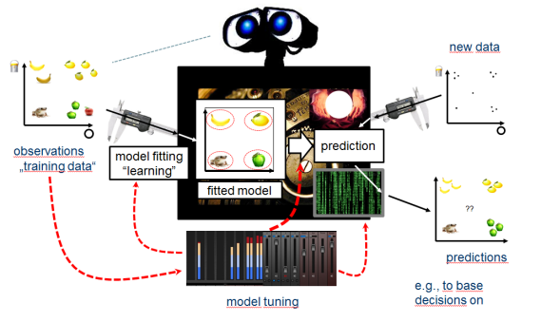


LTCC Courses 2021 Principles and Patterns in Data Scientific Software Engineering
sklearn’s unified estimator interface
from sklearn import SVC
Constructing a supervised classifier – „estimator“ object
clf
clf = SVC(gamma=0.001, C=100.)
clf is a materialized support vector machine – python object of class SVC
with set parameters gamma=0.001, C=100
Fitting the learner to data – numpy arrays X, y
X[:,1]
y
clf.fit(X, y)
clf is now fitted to the data – internal state has changed
X[:,0]
clf.support_vectors_
Using the learner to predict labels for new data X_new
fitted support vectors
y_pred = clf.predict(X_new)
X_new[:,1]
??
y_new
y_pred is numpy array with predictions
X_new[:,0]
First line could have been clf = RandomForest(n_estimators=100)
The rest is the same – unified interface

Slide 3












LTCC Courses 2021 Principles and Patterns in Data Scientific Software Engineering
Composite learners – conceptual model
Tuning
Common examples of composition
Model with tuning parameters
parameters set by data-driven tuning algorithm
Ensembling
C
A
D
A
B
D
B
a number of (possibly „weak“) models
„strong“ ensemble model

